Slide 1
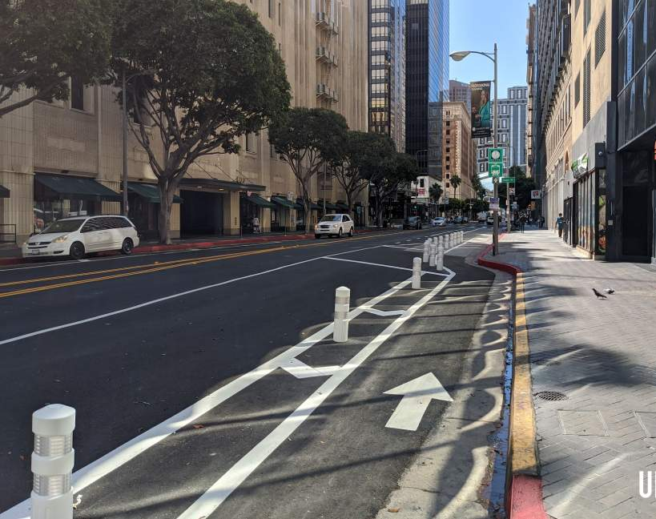
LA City Bike Lane Infrastructure and its Effects on Business Closures from 2016-2021
Authors: Jeff Block, Yocelyne Gomez, Carolina Gonzalez, Miguel Magana and Marco Rodas
Fully Employed MBA Program
California State University Los Angeles
BUS 5100 Business Analytics
Professor Jongwook Woo
https://github.com/COHORT6-FEMBA-CALSTATELA/Bikelane#bikelane

Slide 2
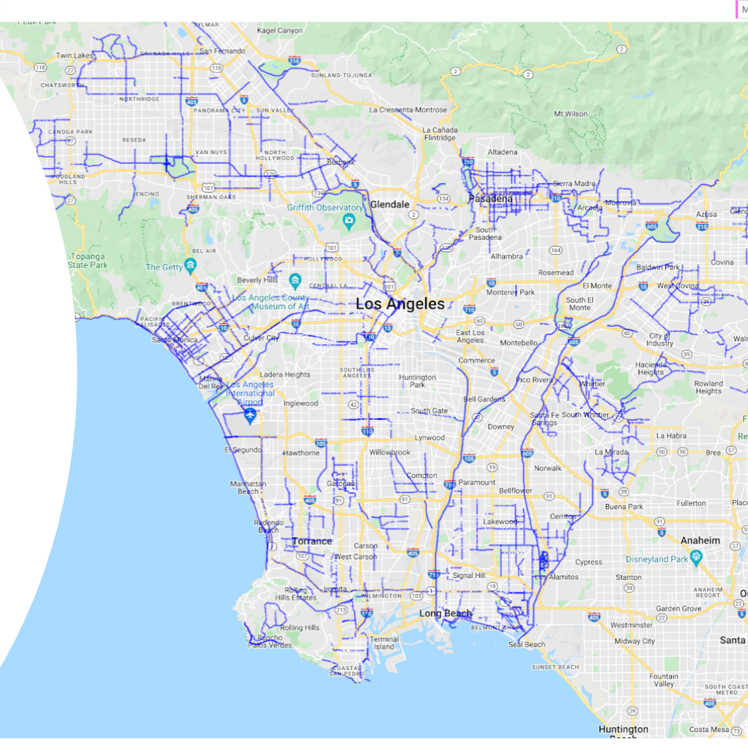
Abstract
Topic: Presence of bike lanes within the city of Los Angeles and how they could offer positive economic benefits to businesses.
It explores the possibility of bicycle infrastructure playing a role in supporting /insulating local businesses from closure.

Slide 3
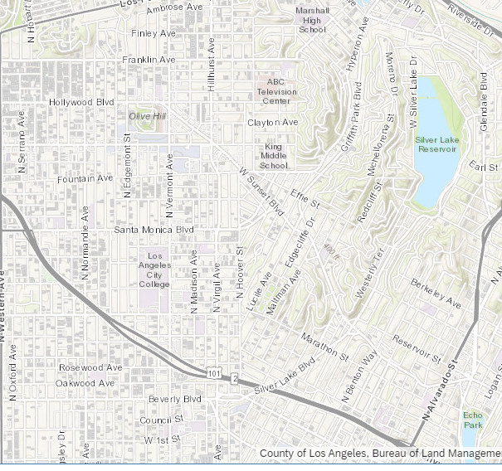
Introduction
To process and visualize the historical data of bike lanes through the city of LA between 2016 and 2021 and understand economic and business impacts of bike lanes on businesses.
Area of study:1.7 miles of Los Angeles
Sunset Blvd. in Silverlake, CA (Glendale Blvd to Santa Monica Blvd) will be our BIKE LANE area of study.
Santa Monica Blvd in Hollywood, CA (Hoover Blvd to Van Ness Blvd) will be our NON-BIKE LANE area of study.

Slide 4
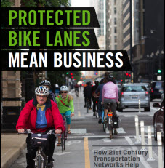
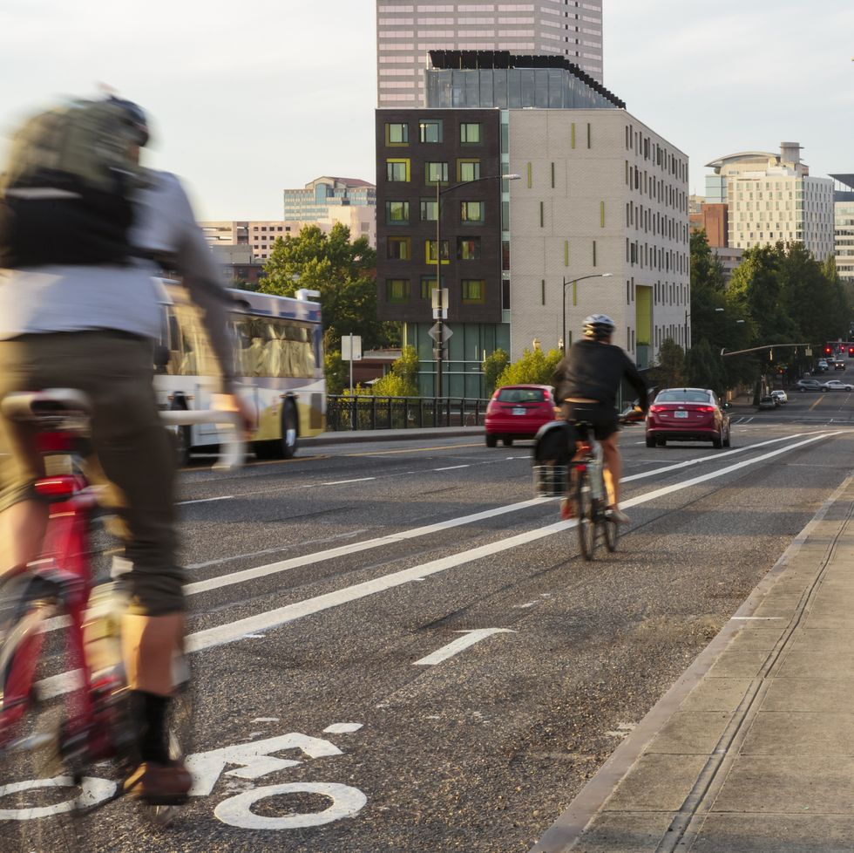
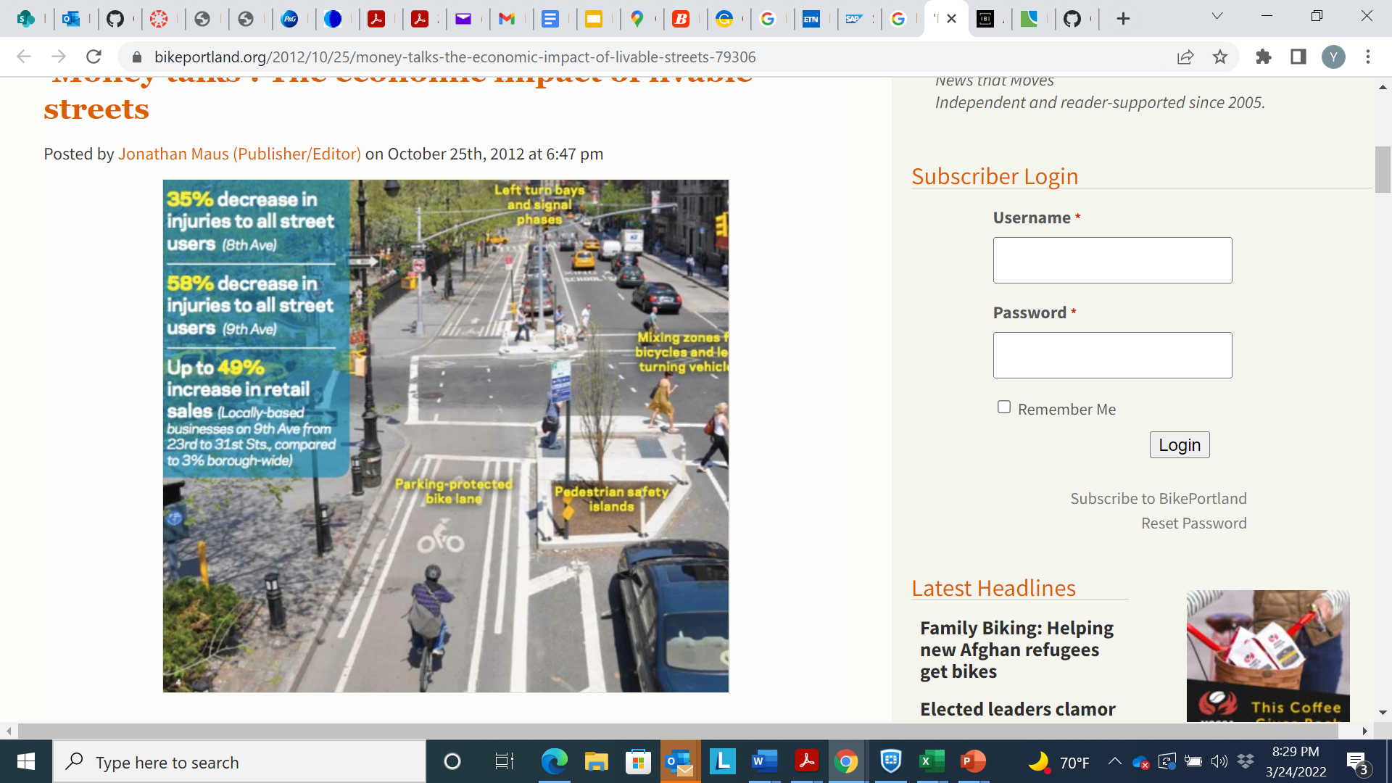
Related Work
It has long been argued that bike lanes provide a positive economic impact on cities (Portland State University)
Other studies argued that bike lanes negatively impacted business (LA Times)
The question returns to “What is the measurable economic impact of bike lanes?”

Slide 5
Specifications
Data Set | Size (Total 6,663 KB)
Listing of Active Businesses (Office of Finance) | 3,706 KB
Bike Lanes (LA DOT) | 123 KB
All Closed Businesses (Office of Finance) | 2,834 KB
Raw datasets were retrieved from lacity.org
Open-source collection of data sets
Bike Lanes data was last updated in November 2020
The business data is updated monthly, last updated March 15, 2022
Table 1. Data Specifications - Bike Lanes and Businesses

Slide 6

Data Cleaning
CSV files were cleaned of excess information non relevant to the project
Listing of Active Businesses CSV file
The remaining data was selected for business status
This data set was then combined with the LA City Bike Lane (LA DOT).

Slide 7
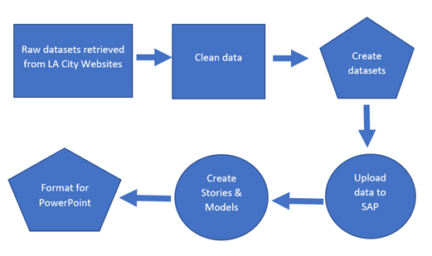
Implementation Flowchart
Step 1. Two downloads from LA City websites.
Step 2. To reflect information needed for our analysis
Step 3. 5 data logs in CSV format
Step 4. Upload Data logs to SAP
Step 5. Provide Analysis & visualizations
Step 6. Format for PowerPoint Presentation
Implementation Flowchart

Slide 8
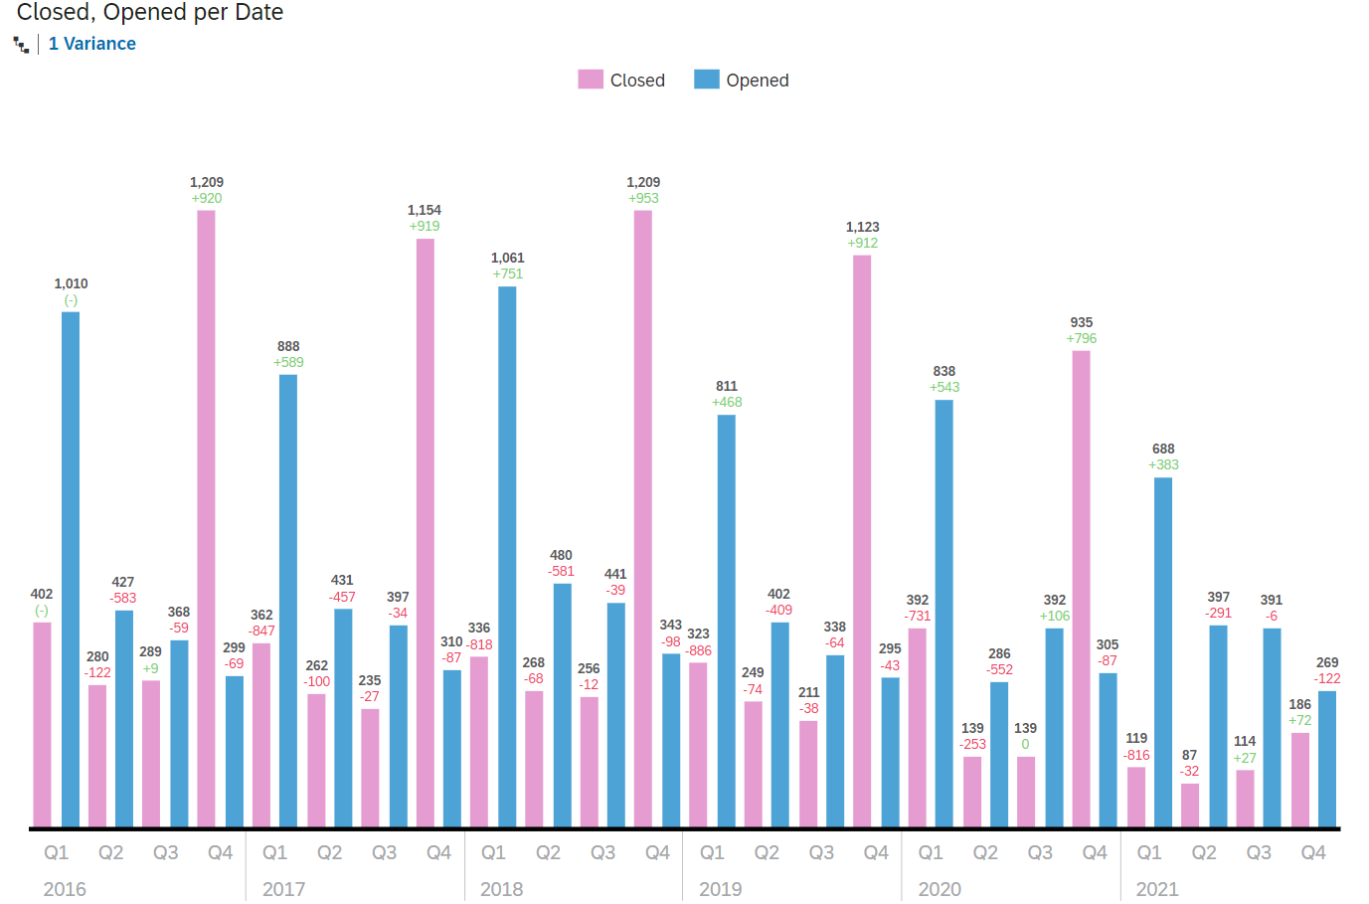
Analysis and Visualization: Bar Chart
This bar chart depicts business activity by quarters
2016 to 2018 the average new businesses annually were 2,151 and closed businesses were 2,087.
2019 to 2021 the new annual businesses opened dropped to 1,804.
2021 the number of businesses that closed dropped to 506 or 32% drop from the previous year.
2016-2021 Open/Closed bar chart
Location: BUS5100Spr2022, Group 2 Project, Group Project Story

Slide 9
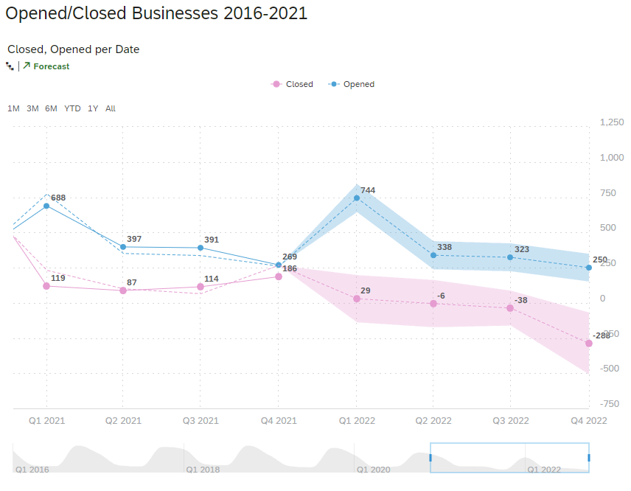
Analysis and Visualization: Time Series
The Time Series chart provides an additional visualization of business activity in the geographical area of analysis
Displays a gradual downtrend from 2016 through 2021 for both new and closed business
Forecast for Q1-Q3 2022 continues to show a downward trend
Time Series Open/Closed Businesses 2016-2021
Location: BUS5100Spr2022, Group 2 Project, Group Project Story

Slide 10
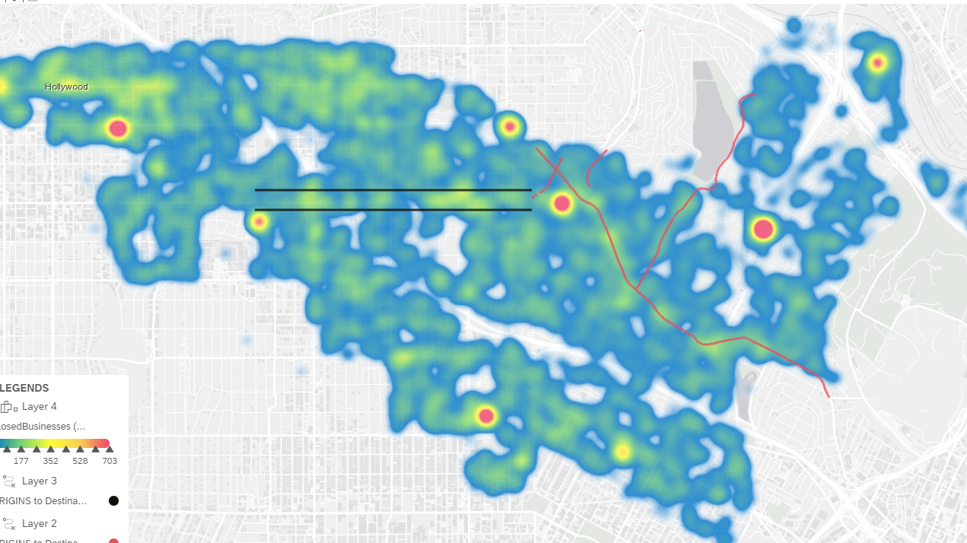
Analysis and Visualization: Heat Map
Heat map determined which areas have a higher concentration of closed businesses
Identified two potential stretches of roads to compare the bike lane to
Hollywood Blvd
Santa Monica Blvd
Time Series Open/Closed Businesses 2016-2021
Location: BUS5100Spr2022, Group 2 Project, Group Project Story

Slide 11
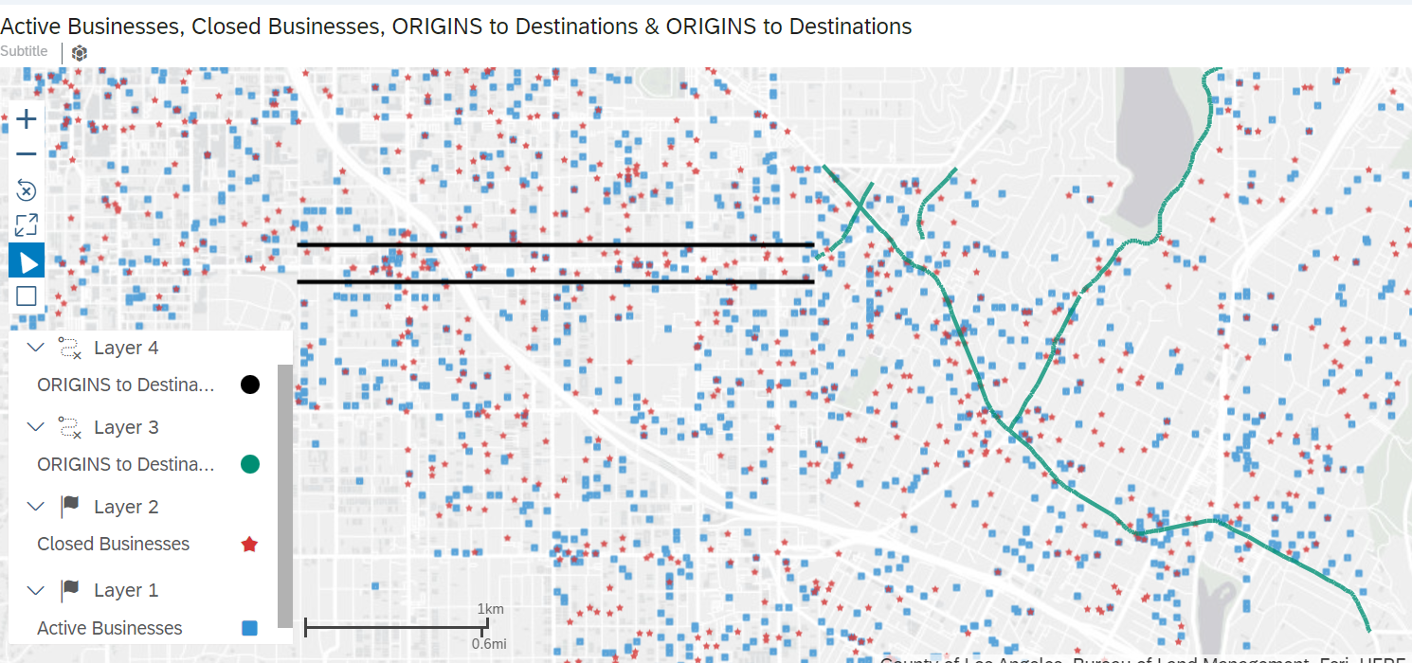
Analysis and Visualization: Geo Map
Geo Map provides visual reference of area of focus as well as a visualization of our study
The focus of our study was District 13.
Features added to the Geo Map were:
Flow layers: Bike lanes and non-bike lanes. Businesses that opened and closed along the bike lanes and the non-bike lane area.
Area of study Geo Map with open/closed.
Location: BUS5100Spr2022, Group 2 Project, Group Project Story

Slide 12
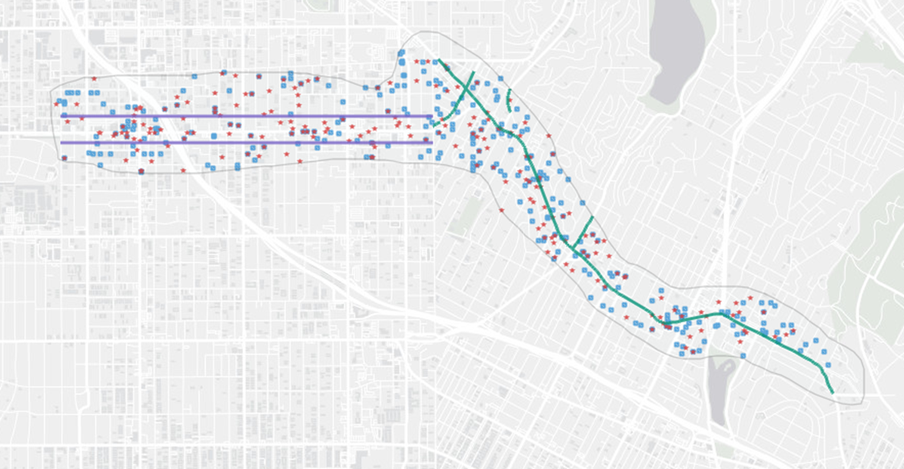
Analysis and Visualization: Geo Map
Utilizing the Polygon Filter setting in the Geo Map we isolated a focused area of new and closed businesses along the bike/non-bike lanes.
Bike Lane: 139 new businesses opened & 82 closed
Non-Bike Lane: 94 new businesses opened & 92 closed
The results confirm our hypothesis that businesses near established bike lane infrastructure are more resilient to closures compared to businesses without the bike lane infrastructure.
Focused area of Geo Map
Location: BUS5100Spr2022, Group 2 Project, Group Project Story

Slide 13
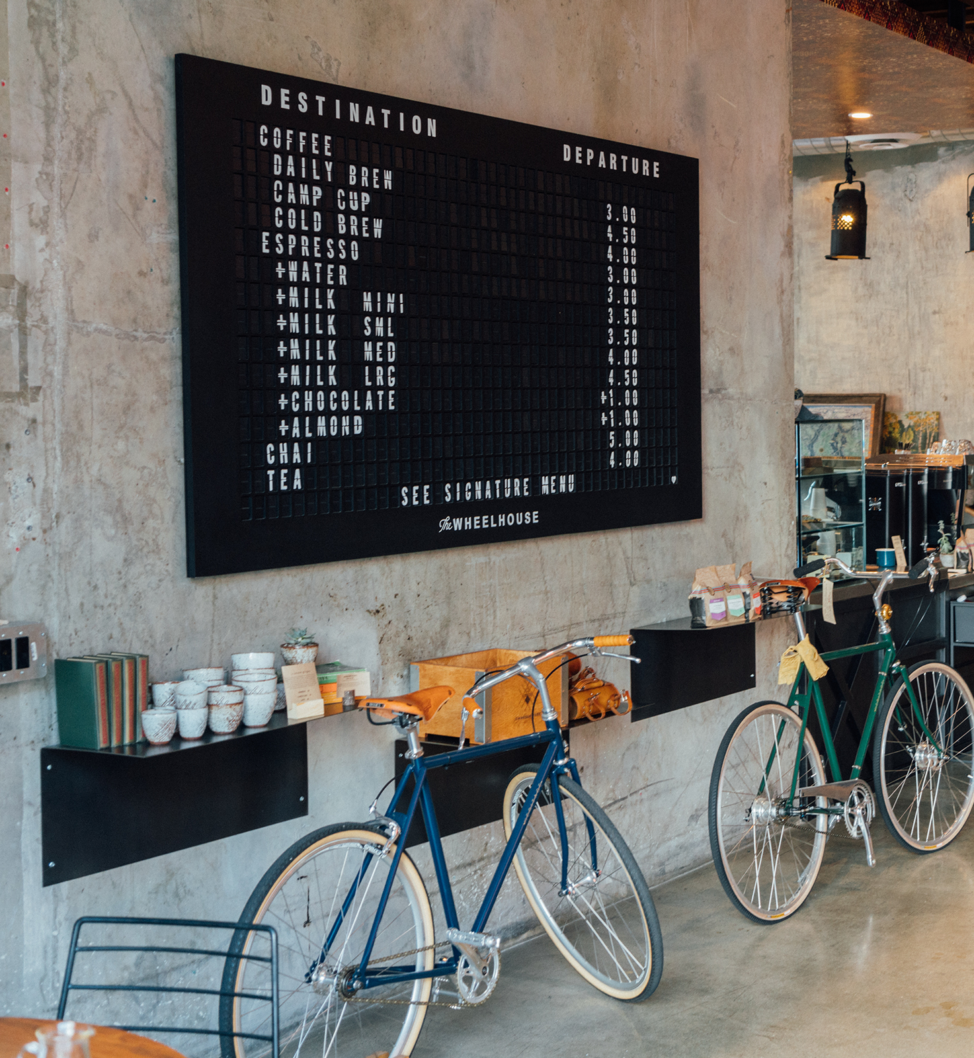
Conclusion
More new business opened on the bike lane than the non-bike lane route.
About the same amount of business closed on both the bike lane and non-bike lane route.
New businesses along the bike lane route were more likely to stay open.
Bike lanes appear to positively affect local business resilience.
Further research is needed to conclude positive economic benefit of bike lanes.

